Slide 1

A presentation on Internship problem Digital Forensic Analyses of TOR And Web Browser Records
Centre of Excellence in Cyber Security Jawaharlal Nehru Technological University Hyderabad
By
Tejaswi Sunarkar, 20011DA817,M.Tech 1st Year CFIS, JNTUH CEH, tejaswisunarkar123@gmail.com
Ambati Bhargav, 18QM1A0406 , B.Tech 3rd Year, ECE, KGRCET, ambatibhargav06@gmail.com
Dasari Gokul Pavan,18BK1A0511 , B.Tech 3rd Year, Computer Science and Engineering, gokulpavan321@gmail.com
By
Jaya Prasad Botsa,Senior Forensic Examiner, jayaprasad.b@hotmail.com
Vasavi.B, Ph.D scholar, JNTUH, vasavi.bande@gmail.com

Slide 2
Abstract
The most widely used applications by the majority of user of computer are Web Browsers. A Web browser is an application program for accessing the Internet. User performs their many activities such as, browsing on the internet, download files, use social media applications, accessing email accounts via web browser and The onion router (Tor).
Tor browser is one such application which not only ensures the privacy preservation goals but also provides promising anonymity. This Private Browser data can be recovered using some recovery tools
During the memory dump using FTK, based on analysis of the browsers in private mode, it was found that browser data was recoverable for all the browsers.

Slide 3
INTRODUCTION
Browser forensic is mainly used for analyzing things like browsing history and general web activity of a pc to check for suspicious usage or content that has been accessed.
This Also refers to monitoring traffic on a webpage and analysis of LOG files from the server to get actual information about the targeted machine.
Computers and their storage media is the object of investigative analysis, known as Computer Forensics, aimed at characterizing and interpreting the digital evidences present on the devices.
To handle information stored at end users’ systems, the different browser vendors have introduced a new feature in their browser called In Private Browsing

Slide 4
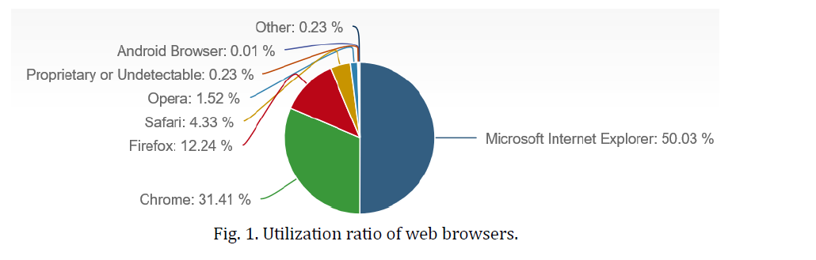
Utilization and Analysis of Web Browser

Slide 5
Area To Focus
Following can be the different sources where an investigator can find evidences in browser.
1. Surfing history
2. Bookmarks
3. Download
4. Cookies
5. Cache

Slide 6
Steps in digital forensic process
1. Assess the crime scene-
To conduct an investigation, one need to obtain proper authorization which would normally include assessing the case, asking people and documenting the results in an effort to identify the crime and location of the evidence.
2.Collection phase-
Here one would need to identify potential sources of data and acquire forensic data from them such as desktops, storage media, routers, cell phones, digital camera etc.. Finding the evidence, discovering their relevance, gathering the evidence, and preparing a chain of custody are the main steps in collection phase
3. Analysis phase-
Examine the collected data/files and find out the actual evidence. The computer forensic investigator must trace, filter, and extract hidden data during the process.

Slide 7
Phase
Report phase-
The audience should be able to understand the evidence data which has been acquired from the evidence collection and analysis phase. The report generation phase records the evidence data found out by each analysis component
Documentation phase-
Documentation is essential for the investigation. For evidence to be reliable in court, integrity has to be preserved. Safe storage and tamper protection is needed

Slide 8
Challenges in Browser Forensic Process
Multiple browsers
Varied storage schemes
New/updated architectures
Non-standard browsers

Slide 9
OBJECTIVE
The aim is to identify and collect evidence and essential information related to a crime from recovered traces of browsing sessions to be used for forensic investigation purposes.
Browsers store a notable proportion of user data and their browsing activities that range from cached files and visited URLs to usernames and passwords used during browsing sessions.
Objective of this research is to collect all the Tor artifacts from the registry, memory and storage of the host machine. For detailed analysis, different scenarios were also considered.

Slide 10
PROPOSED WORK
Our main aim of the project is to analyze web browser activity Digital Forensic Analyses of TOR And Web Browser Records using FTK Imager, SQLite and HDX tools.
Using FTK Imager in our project, we can perform
Creating a Forensic Image
Capturing Memory
HXD: HxD is It is freeware and available in multiple languages. The user-friendly interface of this tool can help extract data readily.
SQLite
SQLite is a forensic tool with a number of functions. It can recover complete SQLite databases, quickly scan SQLite data files, allow SQLite data type mapping, and so on.

Slide 11
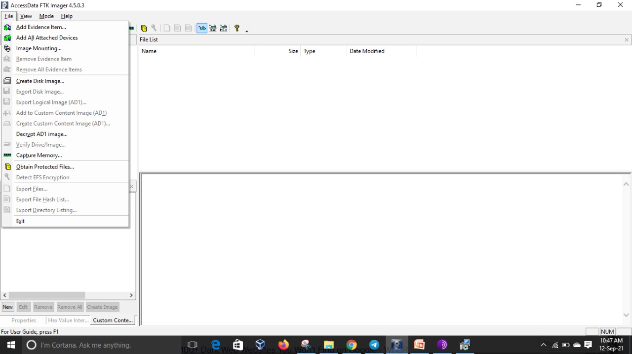
Analysis of TOR Browser History Data
Open FTK Imager and Start capturing the memory

Slide 12
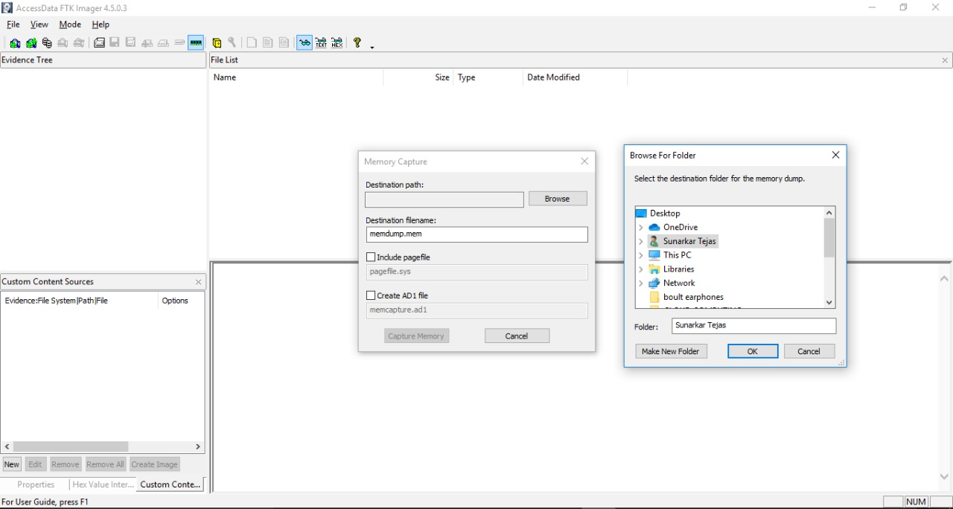
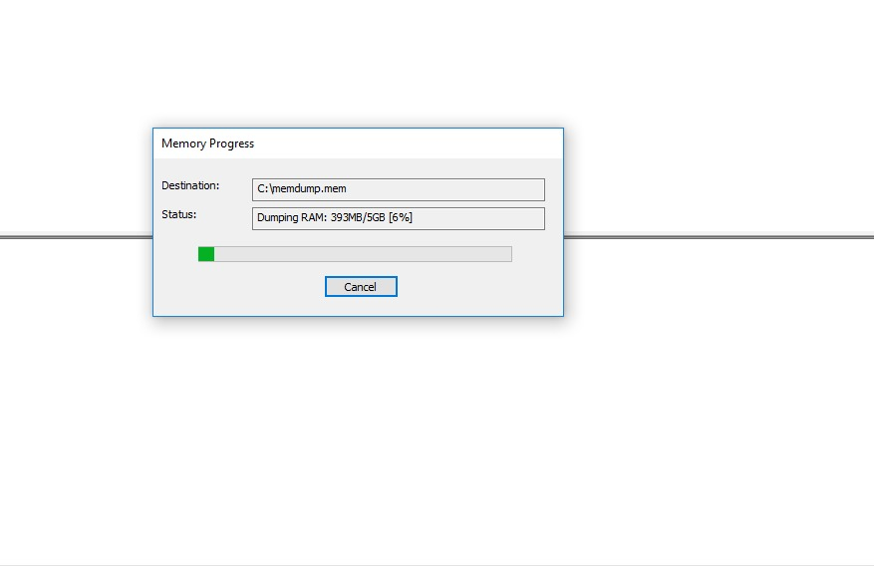
Capturing the memory dump

Slide 13
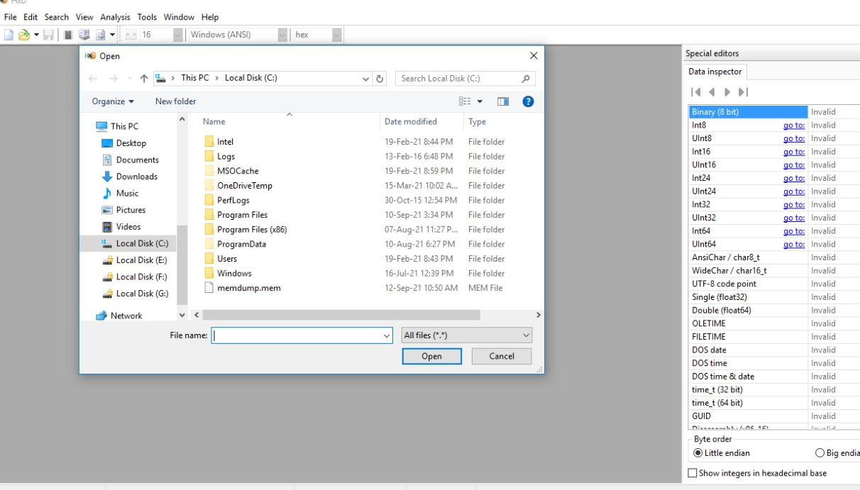
HDX TOOL

Slide 14
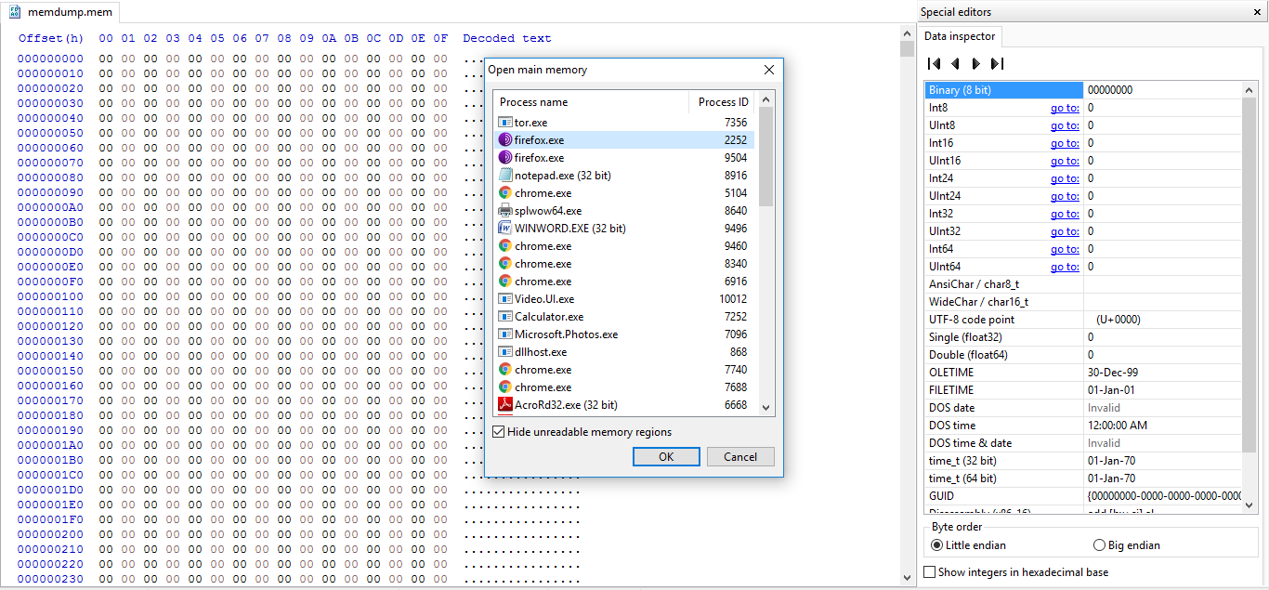
TOR BROWSER History

Slide 15
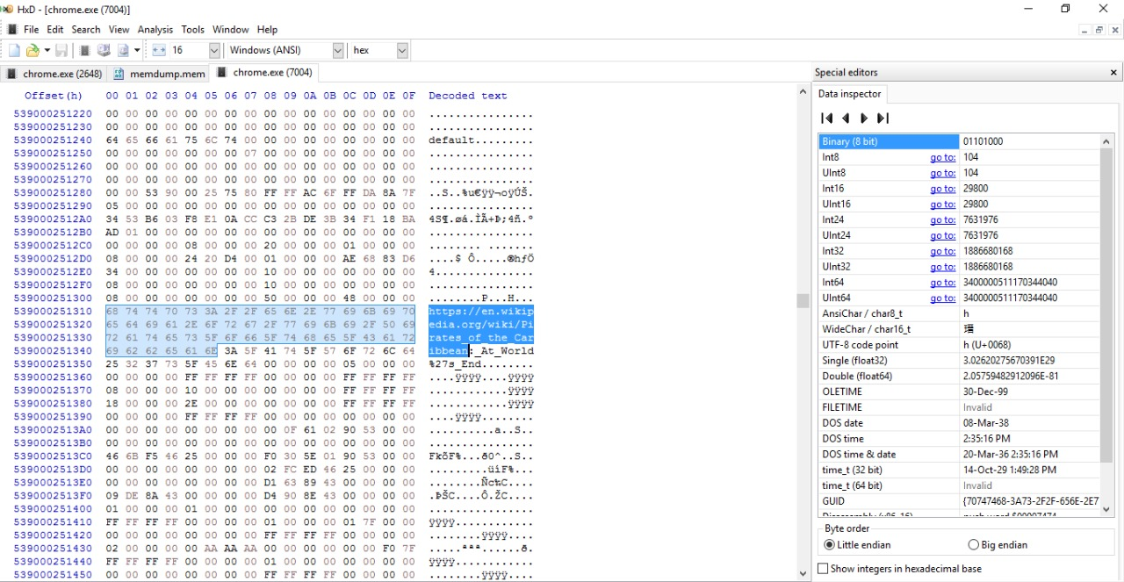
Browser History of Chrome(Incognito)

Slide 16
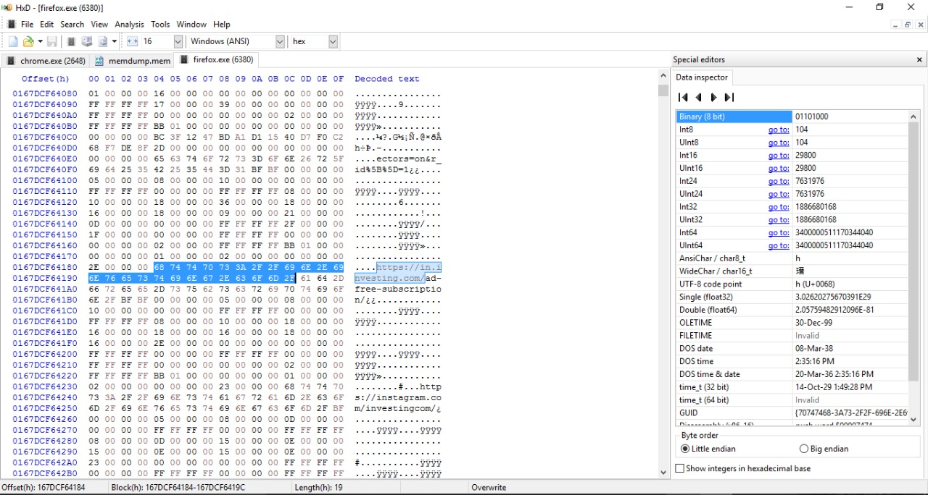
Browser History of Mozilla(Private Browser)

Slide 17
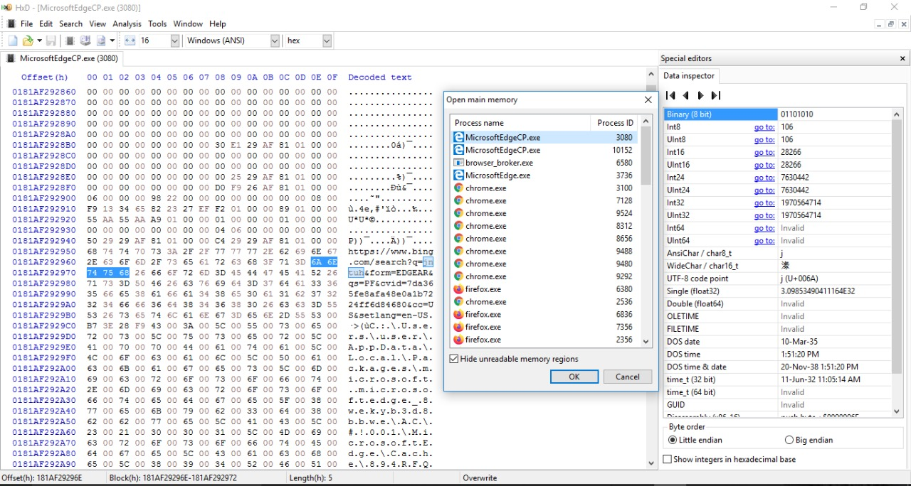
Browser History of Microsoft Edge
(New PrivateWindow)

Slide 18
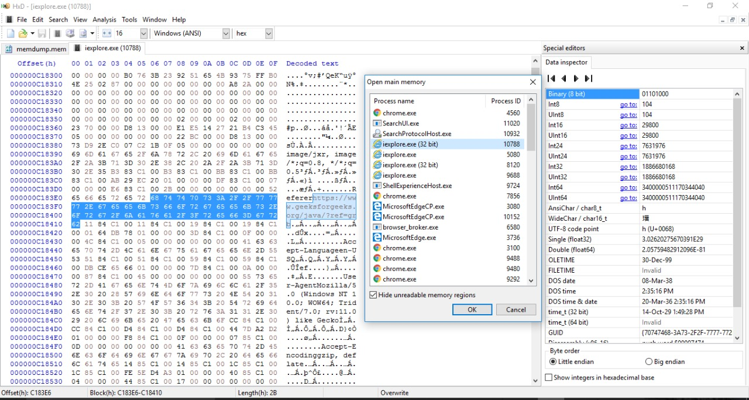
Browser History of Internet Explorer
(In private Browsing)

Slide 19
File Location in the Web Browser Operating System
Web Browser | Operating System | File Path
Google Chrome | Windows 10 | C:\Users\%username%\AppData\Local\Google\Chrome\User Data\Default\Preferences
 | Windows 7 | C:\Users\%username%\AppData\Local\Google\Chrome\User Data\Default\Preferences
 | Windows XP | C:\Documents and Settings\%username%\Local Settings\Application Data\Google\Chrome\User Data\Default\Preferences
 | Linux | /home/$USER/.config/google-chrome/Default/Preferences
 | Mac OS | /Users/$USER/Library/Application Support/Google/Chrome/Default/Preferences

Slide 20
File Location in the Web Browser Operating System
Web Browser | Operating System | File Path
Firefox | Windows 10 | C:\Users\%USERNAME%\AppData\Roaming\Mozilla\Firefox\Profiles\%PROF ILE%.default\places.sqlite
 | Windows 7 | C:\Users\%USERNAME%\AppData\Roaming\Mozilla\Firefox\Profiles\%PROF ILE%.default\places.sqlite
 | Windows XP | C:\Documents and Settings\%username%\Application Data\Mozilla\Firefox\Profiles\%PROFILE%.default\places.sqlite
 | Linux | /home/$USER/.mozilla/firefox/$PROFILE.default/places.sqlite
 | Mac OS | /Users/$USER/Library/Application Support/Firefox/Profiles/$PROFILE.default/places.sqlite

Slide 21
File Location in the Web Browser Operating System
Web Browser | Operating System | File Path
Opera | Windows 10 | C:\Users\%username%\AppData\Roaming\Opera\Opera\
 | Windows 7 | C:\Users\%username%\AppData\Roaming\Opera\Opera\
 | Windows XP | C:\Documents and Settings\%username%\Application Data\Opera\Opera\
 | Linux | /home/$USER/.opera/
 | Mac OS | /Users/$USER/Library/Opera/

Slide 22
File Location in the Web Browser Operating System
Web Browser | Operating System | File Path
Safari | Windows 10 | \ C:\Users\%username%\AppData\Local\Apple Computer\Safari\
 | Windows 7 | \ C:\Users\%username%\AppData\Local\Apple Computer\Safari\
 | Windows XP | C:\Documents and Settings\%username%\Local Settings\Application Data\Apple Computer\Safari\
 | Mac OS | /Users/$USER/Library/Caches/com.apple.Safari/

Slide 23
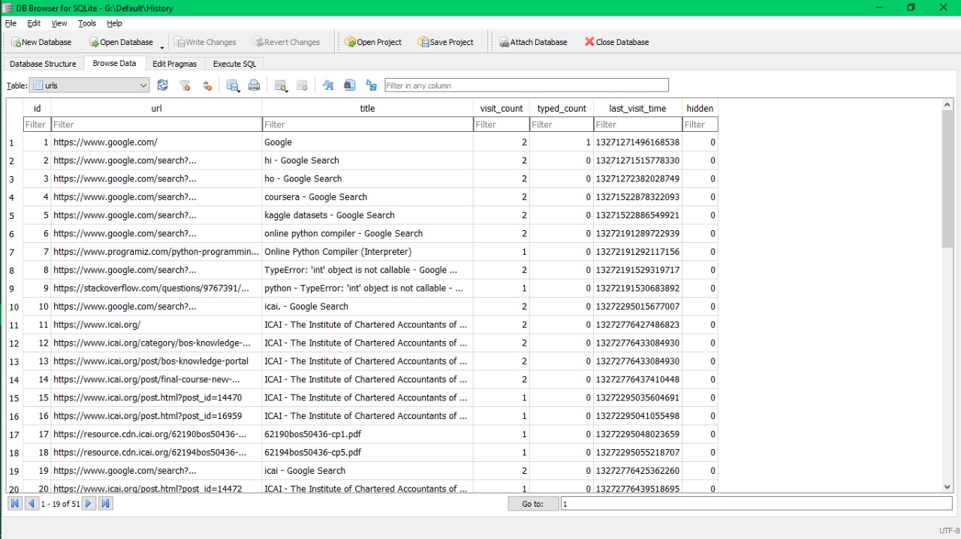
Analysis of Chrome History Data

Slide 24
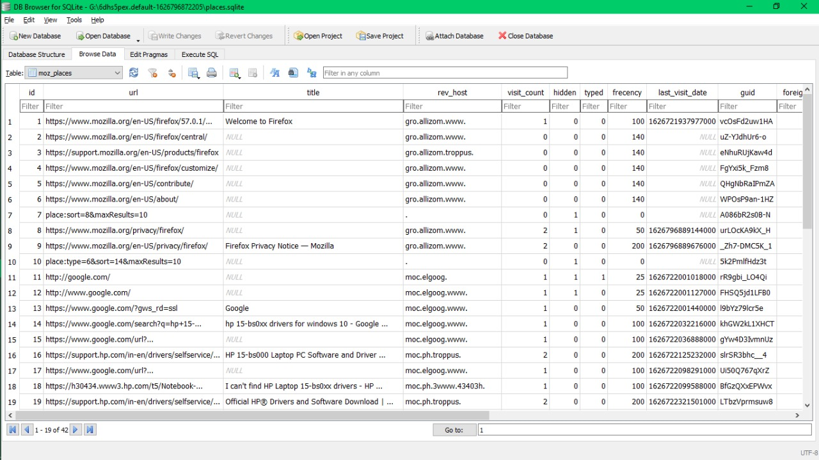
Analysis of FireFox History Data

Slide 25
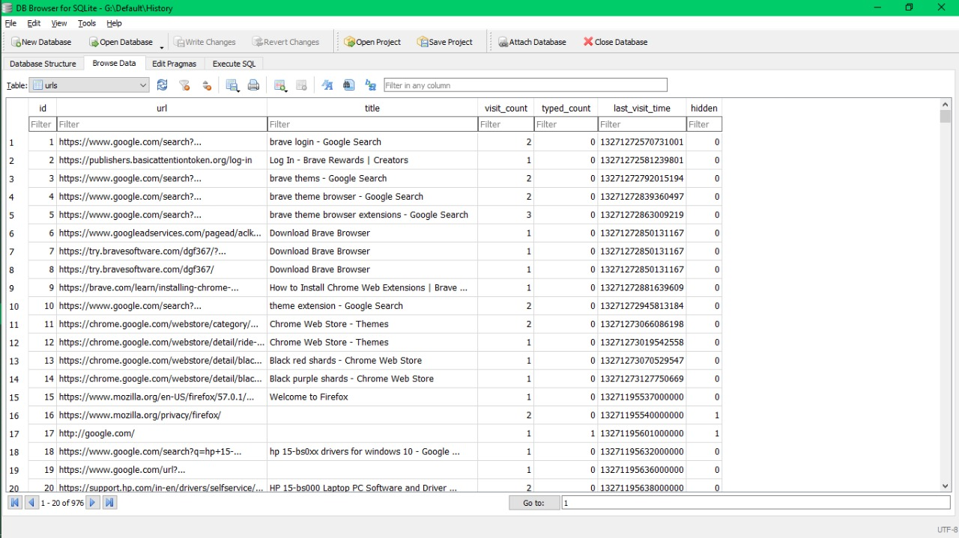
Analysis of Brave Browser History Data

Slide 26
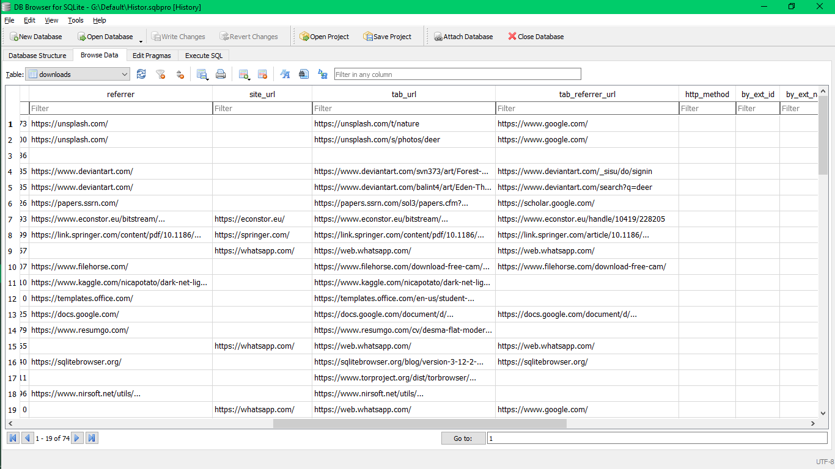
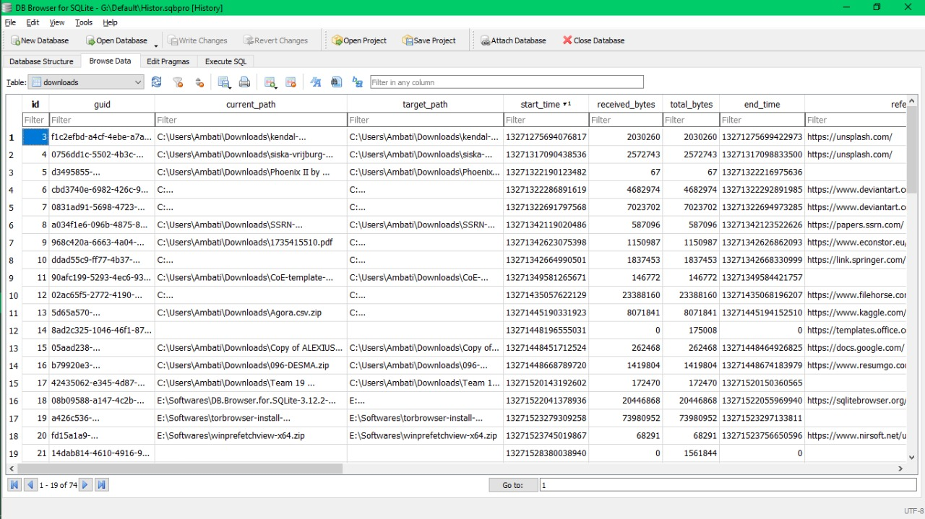
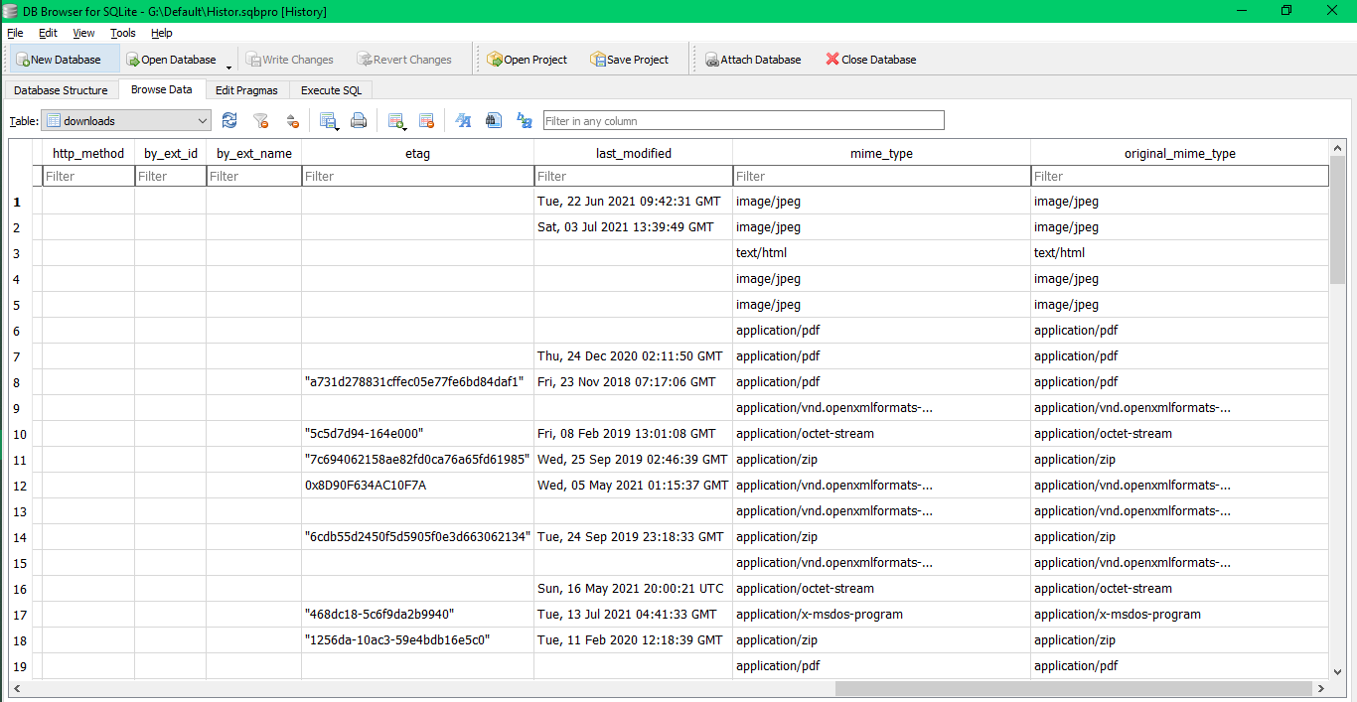
Download Analysis

Slide 27
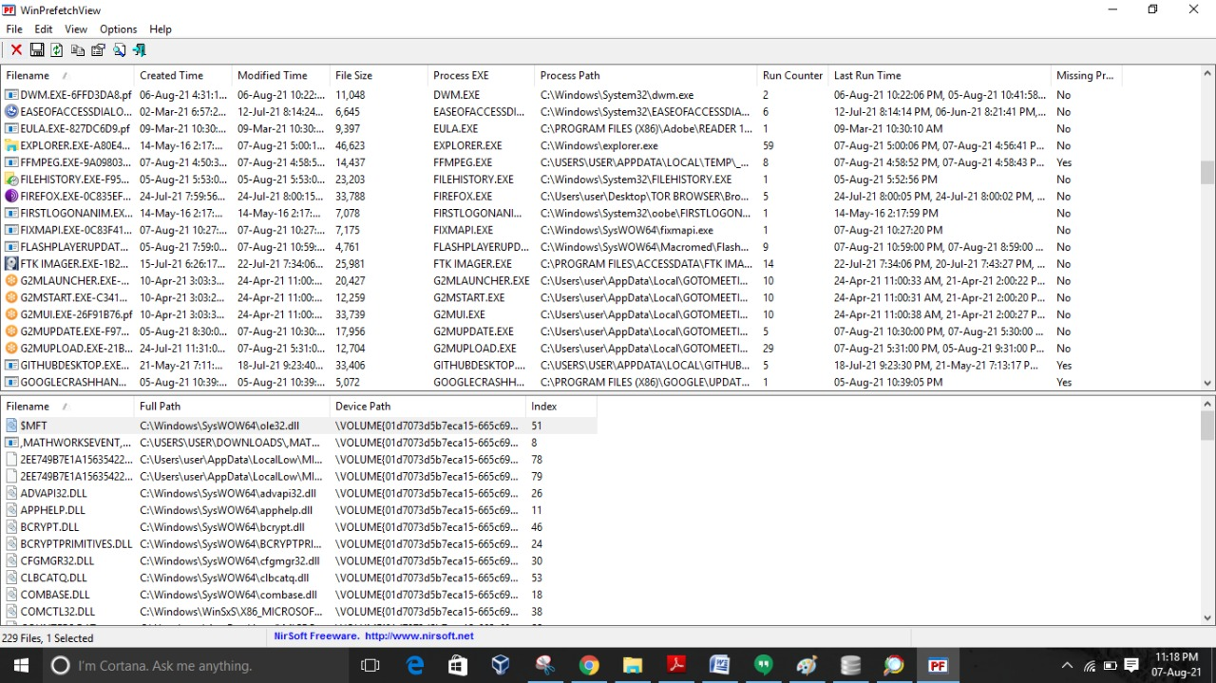
Win PreFetch View

Slide 28
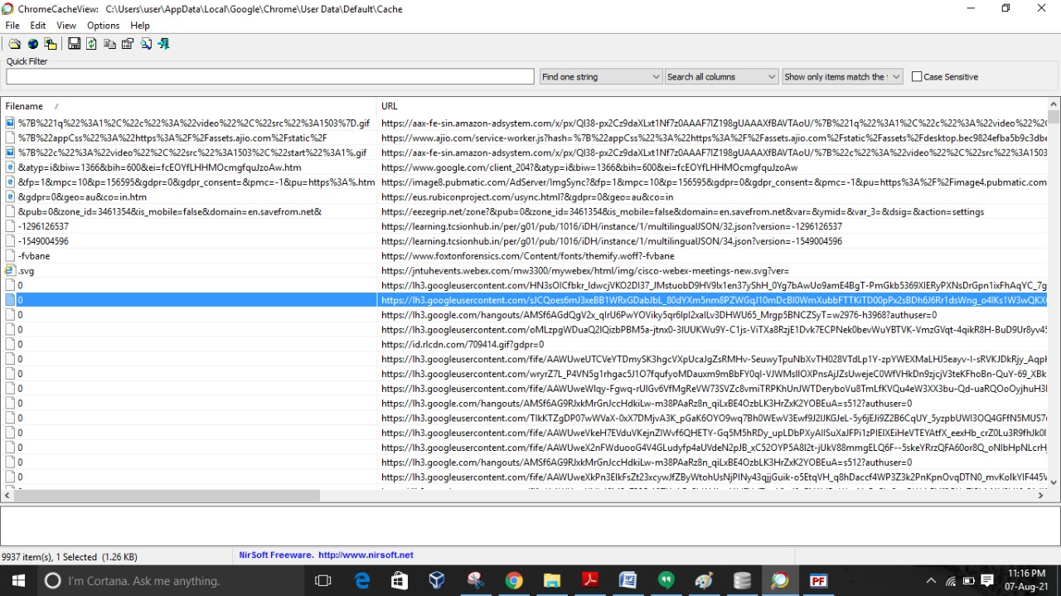
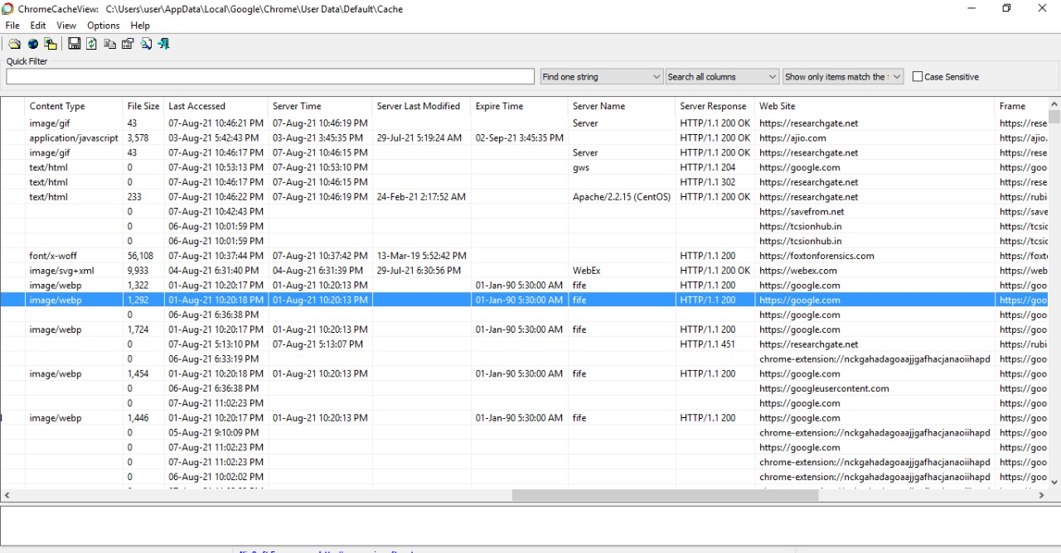
CromeCacheViewer

Slide 29
THANK YOU

